Slide 1
TABLE OF CONTENTS
01 | STAR SCHEMA
02 | EXAMPLE
03 | DESIGNING THE MODEL
04 | WHY STAR SCHEMA
05 | DATA UNDERSTANDING
06 | DATA MODELING
07 | ANALYSIS AND EVALUATION
08 | REPORTING
09 | RECOMMENDATIONS
10 | CONCLUSION

Slide 2

STAR SCHEMA
01

Slide 3
STAR SCHEMA
According to the research of Kimball (2013) the star model has:
A middle table that is the fact table & a set of surrounding tables that are the dimension tables.
The dimension tables are arranged around the main table in a star like arrangement.
Fact tables contains numerical values and foreign keys from the surrounding dimension tables.
Dimension tables contain descriptive information.

Slide 4
- Business Intelligence
Building reports
Dashboards
Simplifies data extraction
Identify trends, patterns and anomalies
Can also be used in Analytics and Data mining, Financial Analytics, Healthcare analytics etc
- Simple
- Easy to understand
- Quick performance | due to denormalized data
queries can be executed faster
Identify business requirements
Choose the right data types
Use appropriate ETL tools (Extract, Transform and Load)
-Validate data quality.
- Inflexibility
- Changes require altering the entire structure (Time consuming and complex)
- Potential for data redundancy
Use Case
Best Practices
Pros
Cons

Slide 5
02
EXAMPLE

Slide 6
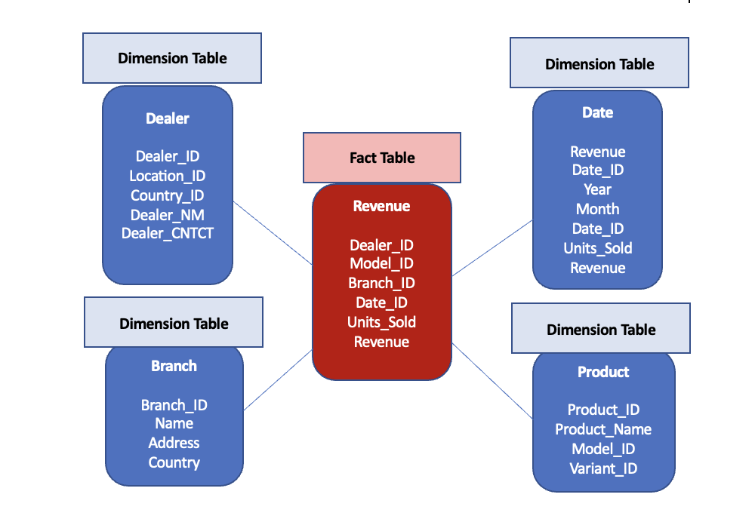
Star Schema Use Case
According to Taylor (2020), the Star Schema can be used for Sales, Financial, Healthcare databases.
The revenue use case has 5 tables. One is a fact tables & the other tables are dimensions tables that describe the fact table.
Revenue table is the Fact Table.
Dealer, Date , Branch and Product tables are the Dimension tables.
Using this datasets we can determine the highest revenue generated by which branch by which dealer in which product and in which time .
Notes:
Source : https://www.guru99.com/star-schema-in-data-warehouse-modeling.html

Slide 7
03
DESIGNING THE MODEL
The use case we are using here refers to the dataset we are using from Question 5-9

Slide 8
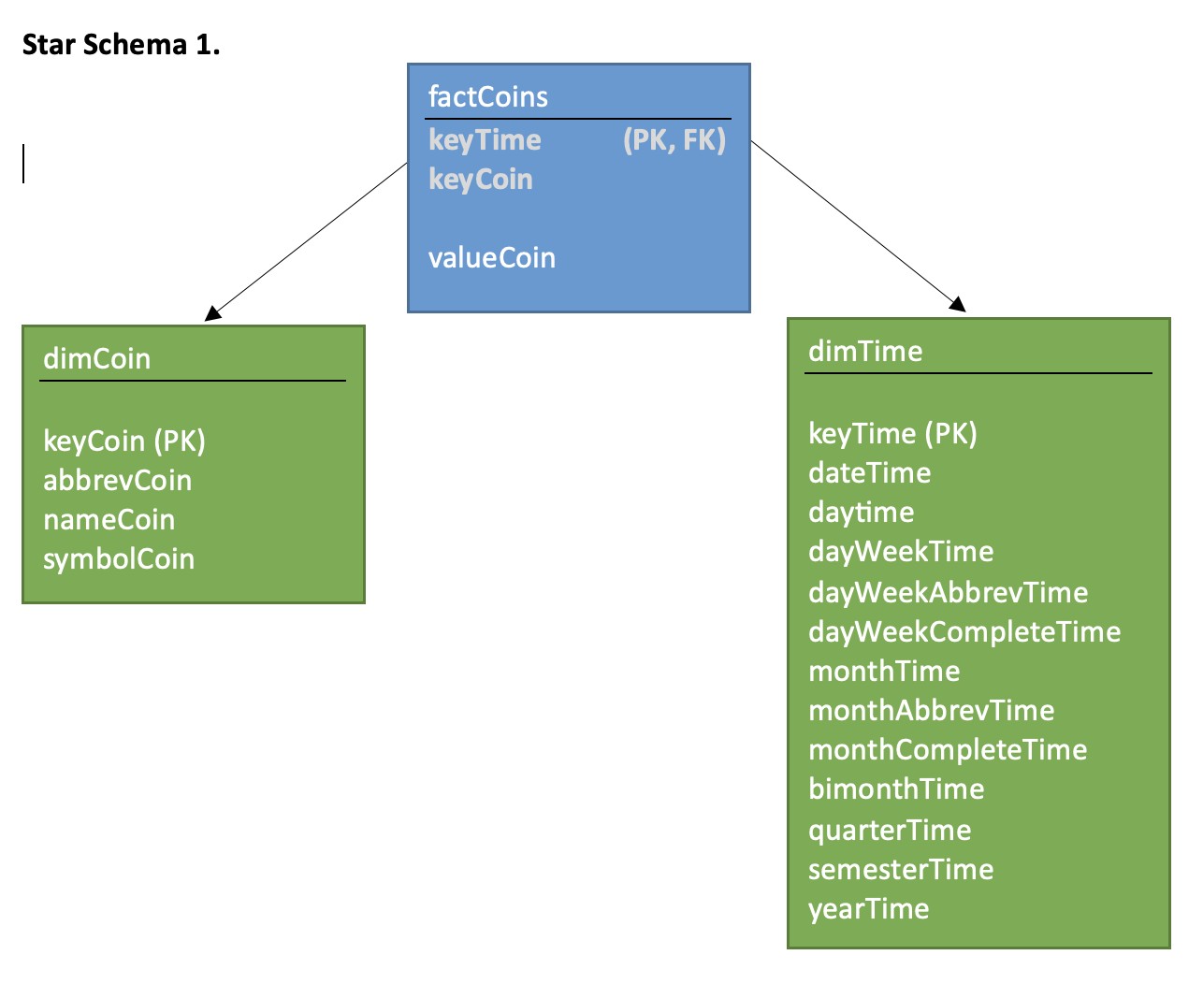
Star Schema 1
(www.kaggle.com, n.d.)
Notes:
Question 3

Slide 9
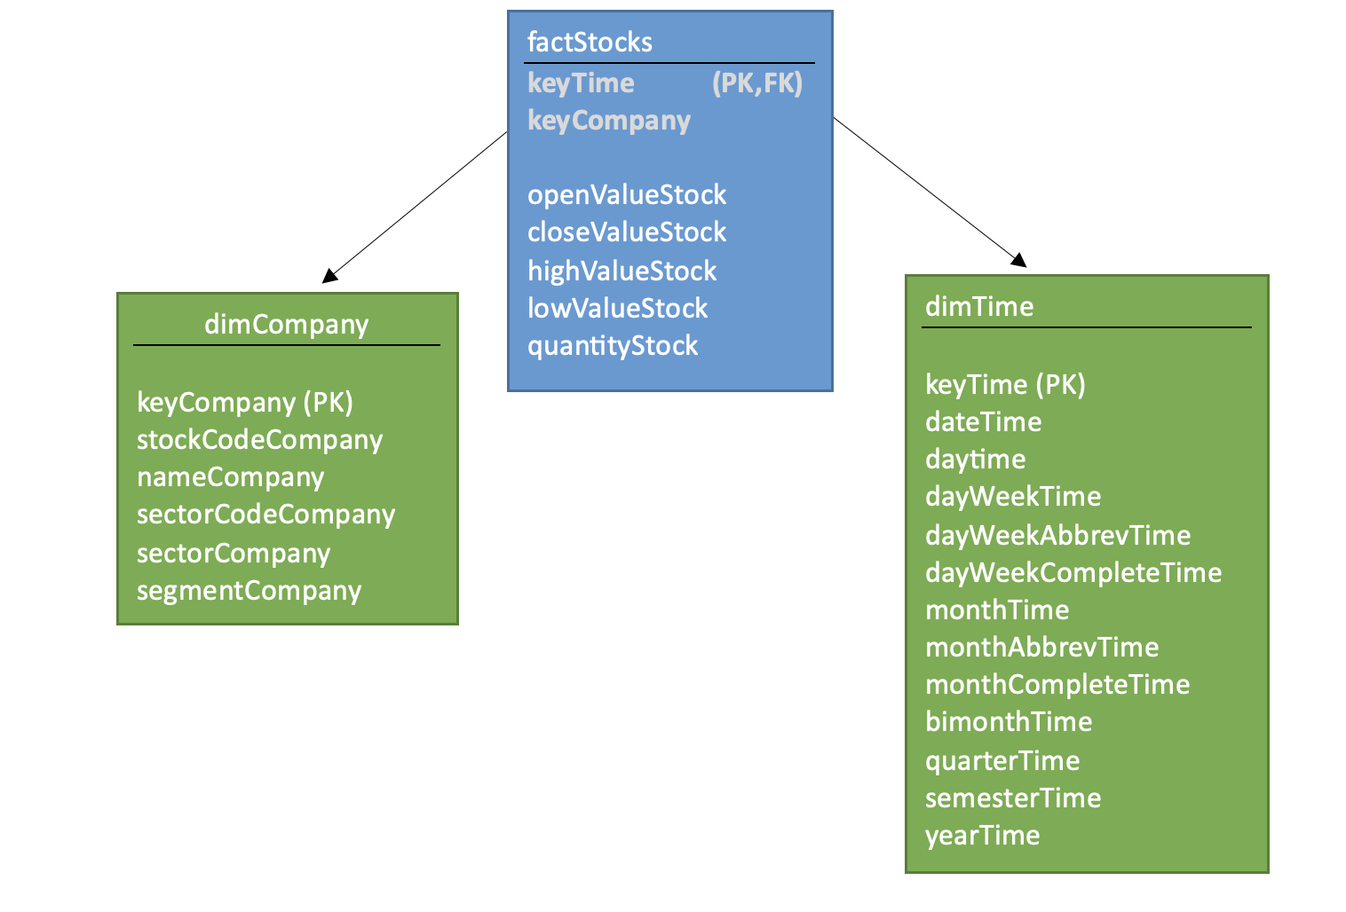
Star Schema 2
(www.kaggle.com, n.d.)

Slide 10
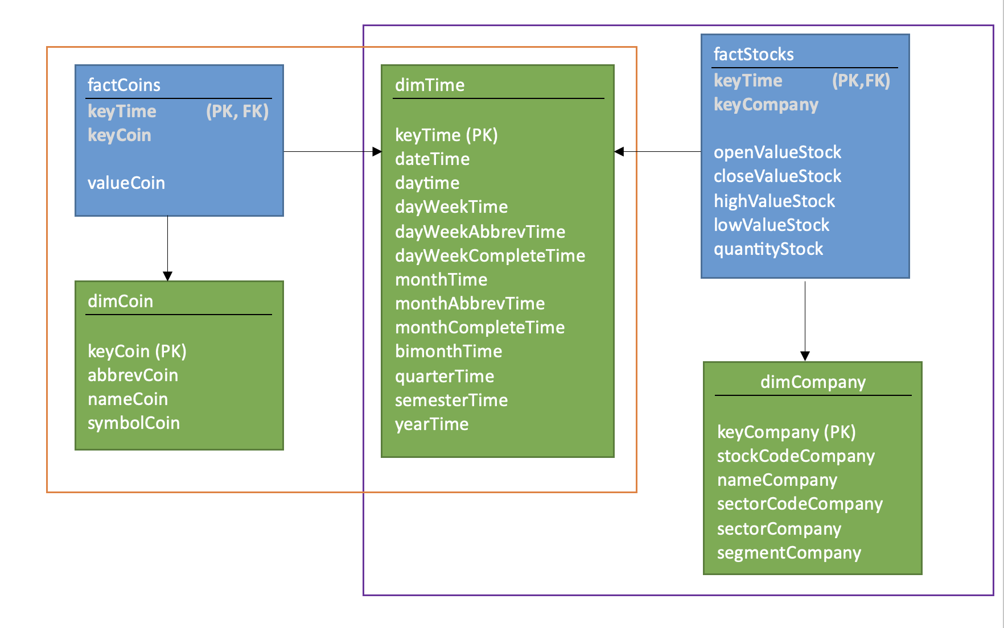
Star Schema 1+2
(www.kaggle.com, n.d.)

Slide 11
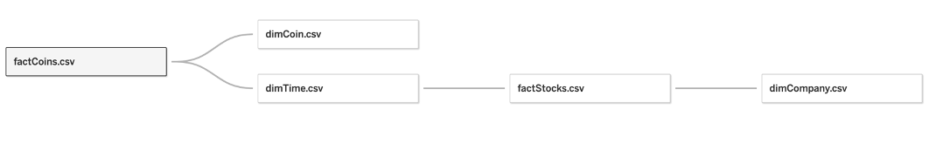
Designing the Star Schema Model for the Brazilian Stock Market in Tableau

Slide 12

How we Designed the Model in Tableau
3 easy steps:
Connect to the data source
Connect factCoins with dimCoin & dimTime
Connect factStock with dimCompany & dimTIme

Slide 13
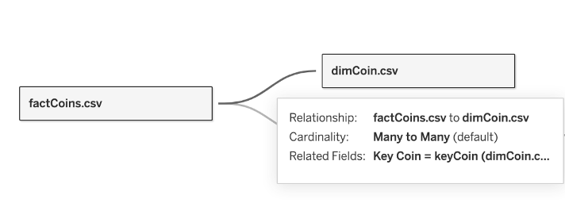
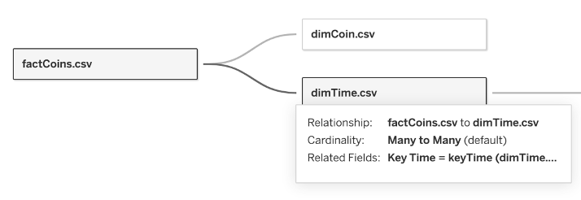
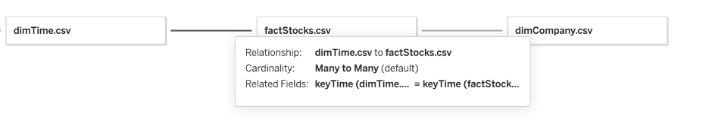
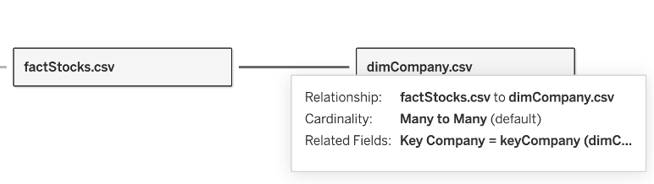
1️⃣
2️⃣
3️⃣
4️⃣

Slide 14

Challenges
Understanding the stock market basic ideas & terminologies
Understanding & finding the relationship between the different tables.
Finding the key that will connect the tables together.
Huge amounts of data from 1994 – 2020.

Slide 15
04
WHY STAR SCHEMA?

Slide 16
STAR |  | Historical Data Analysis | High query performance
3NF |  | Normalization | Higher Processing
DATA VAULT |  | Real Time Data Requirements | Lack of Correlation Analysis
SNOWFLAKE |  | Can result in a highly complex database schema for the stock market | Difficult to query across multiple dimensions

Slide 17
05
Brazilian Stock Market
DATA
UNDERSTANDING
Notes:
Resource

Slide 18
About Datasets
Our dataset is based on the Brazilian Stock Market, which offers information on stock prices and numerous organizations from the Brazil Stock Market (1994-2020).
This dataset is split into five tables of which 2 are Fact Tables and 3 are Dimension Tables
factCoins
dimCompany
1st
2nd
3rd
4th
5th
factStocks
dimTime
dimCoin
(www.kaggle.com, n.d.)

Slide 19
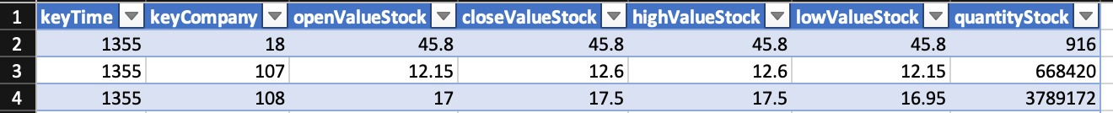
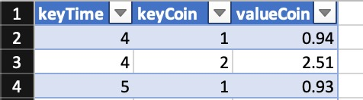
About Variables
factStocks - Fact table with stock prices over time.
factCoins- Fact table with coin value over time.

Slide 20
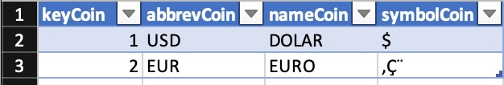
dimCoin - Dimension table with information about the coins.
dimCompany - Dimension table with information about the companies.
dimTime - Dimension table with information about the datetime.

Slide 21
Business Questions
Stock market analysis:
What was the opening, closing, high, low values of different stocks on a particular day?
Currency exchange analysis:
What was the exchange rate of different currencies on a particular day?
Time and date analysis:
Which days of the week had the highest trading volume or exchange rate?
Company and sector analysis:
How did different companies or sectors perform in the stock market?
(www.kaggle.com, n.d.)

Slide 22
06
MODELING

Slide 23
Joining Tables for Analysis
To analyze how different companies or sectors performed in the stock market, we combined the provided datasets using their respective keys.
We combined the tables factStocks, factCoins and dimTime using the 'keyTime' column and with dimCompany using 'keyCompany' (using joins in SQL)

Slide 24
Creation of a New Column for Analysis
Calculated the daily percentage change in stock prices for each company, and included this information as a new column in the new dataset .

Slide 25
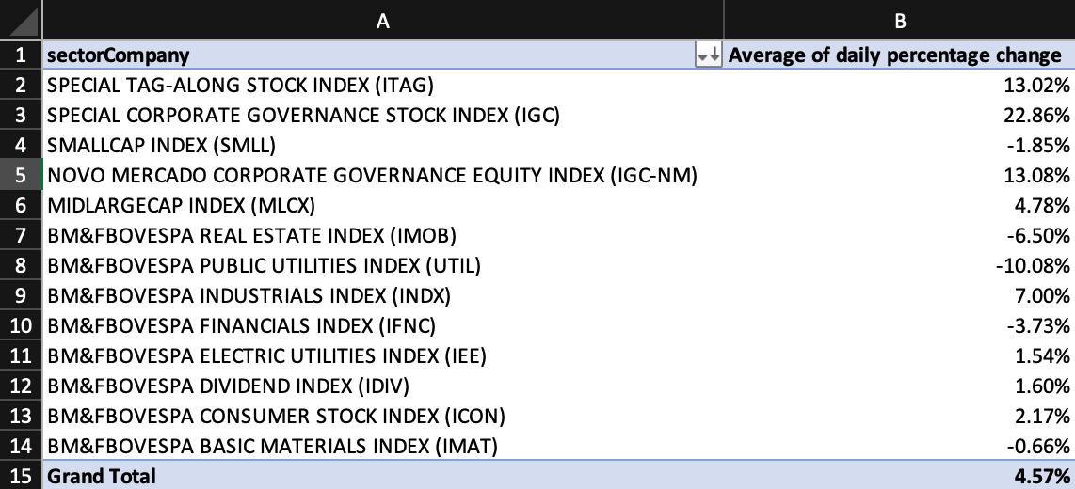
Creation of a Pivot Table for Analysis
Aggregated the daily percentage change data by sector to calculate the average performance of each sector over time (using pivot tables)

Slide 26
07
ANALYSIS & EVALUATION

Slide 27
Business Strategies
Buy & hold (Beers, 2020)
Value investing (Hayes, 2022)
Growth investing (Segal, 2019)
Business Requirements
Transparency
Accessibility
Regulation
Liquidity
Security

Slide 28
08
REPORTING

Slide 29
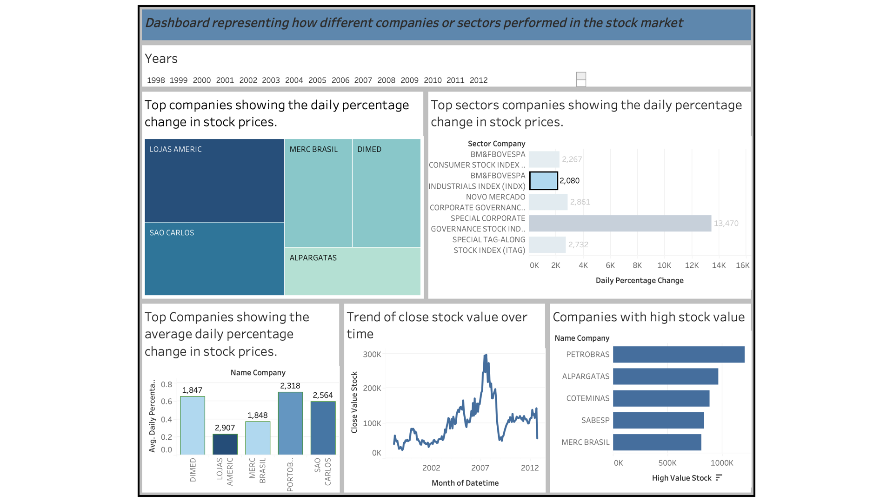

Slide 30


Slide 31
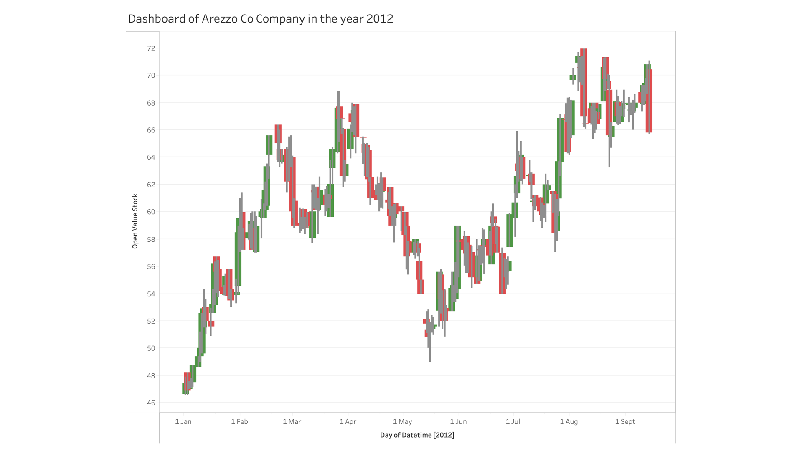
A PICTURE IS WORTH A THOUSAND WORDS
Notes:
Tala

Slide 32
09
RECOMMENDATIONS

Slide 33
Our Recommendations
Based on our analysis and reports, the following overall recommendations can be given:
By diversifying investments across different sectors, investors can mitigate the risk of losses in case of underperformance of a specific sector.
The daily percentage change in stock prices can indicate the volatility and trend of a particular stock. Investors can consider this information when making investment decisions.
Investors can consider the correlation between daily percentage change in stock price information when building a portfolio to ensure that their investments are not highly correlated, which can increase risk.

Slide 34
10
CONCLUSION

Slide 35
Conclusion
Two star models lengthening analysis time.
Difficulties with data preparation, visualization, and using Tableau.
Numerous stock market data points.
A full investigation requires interaction.
A need for tools for data visualization and programming skills.
Difficulties in gathering and evaluating datasets are comparable.

Slide 36
REFERENCES
Beers, B. (2020). How a Buy-and-Hold Strategy Works. [online] Investopedia. Available at: https://www.investopedia.com/terms/b/buyandhold.asp.
Hayes, A. (2022). Value Investing. [online] Investopedia. Available at: https://www.investopedia.com/terms/v/valueinvesting.asp.
Kimball, R. (2013). The data warehouse toolkit : the definitive guide to dimensional modeling. Wiley, Sydney.
Segal, T. (2019). Is Growth Investing the Right Money-Making Method for You? [online] Investopedia. Available at: https://www.investopedia.com/terms/g/growthinvesting.asp.
Taylor, D. (2020). What is Star Schema in Data Warehouse modeling? [online] www.guru99.com. Available at: https://www.guru99.com/star-schema-in-data-warehouse-modeling.html.
Tretina, K. (2021). How Does The Stock Market Work? [online] Forbes Advisor. Available at: https://www.forbes.com/advisor/investing/what-is-the-stock-market/.
www.kaggle.com. (n.d.). Brazil Stock Market - Data Warehouse. [online] Available at: https://www.kaggle.com/datasets/leomauro/brazilian-stock-market-data-warehouse [Accessed 8 May 2023].

Slide 37
THANK YOU!

